Slide 1
Costs of Production (chapter 13, Mankiw and Chapter 9, Powell)
The economy is made up of thousands of firms that produce the goods and services you enjoy every day: General Motors produces automobiles, General Electric produces light bulbs, and General Mills produces breakfast cereals. Some firms, such as these three, are large; they employ thousands of workers and have thousands of stockholders who share in the firms’ profits. Other firms, such as the local barbershop or candy store, are small; they employ only a few workers and are owned by a single person or family.
introduce you to a part of economics called industrial organization—the study of how firms’ decisions about prices and quantities depend on the market conditions they face.

Slide 2
Total Revenue, Total Cost, and Profit
The amount that the firm receives for the sale of its output (cookies) is called its total revenue.
Total cost: The amount that the firm pays to buy inputs (flour, sugar, workers, ovens, and so forth) is called its total cost
Profit = Total revenue – total cost

Slide 3
Two types of costs
explicit costs input costs that require an outlay of money by the firm. expenditures on foods, utilities, wages and bank interest are explicit costs.
implicit costs input costs that do not require an outlay of money by the firm. Uses its own capital or Uses its owner’s time or financial resources.

Slide 4
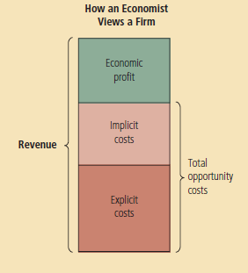

Slide 5
Production and Costs
Firms incur costs when they buy inputs to produce the goods and services that they plan to sell. In this section, we examine the link between a firm’s production process and its total cost.
We assume that the size of Caroline’s factory is fixed and that Caroline can vary the quantity of cookies produced only by changing the number of workers she employs. This assumption is realistic in the short run but not in the long run. That is, Caroline cannot build a larger factory overnight, but she can do so over the next year or two. This analysis, therefore, describes the production decisions that Caroline faces in the short run.
production function: the relationship between quantity of inputs used to make a good and the quantity of output of that good.

Slide 6
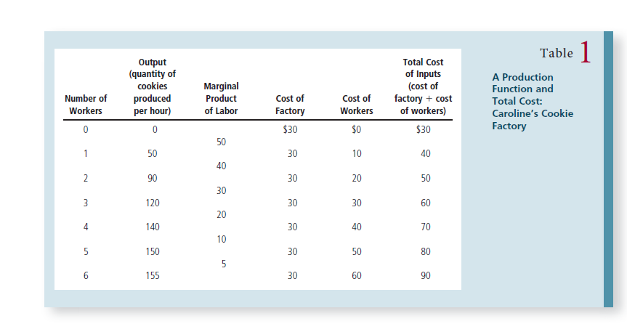

Slide 7
What is happening in table 1
What do you mean by Marginal Product of labor? The change in output(what you are producing) as you employ an extra labor.
Can you identify the fixed cost/variable cost? And why?
Can we plot this? If so, which one is the dependent variable and which one is the independent variable.
Bonus Mark: if you can draw a rough diagram of the production function.

Slide 8
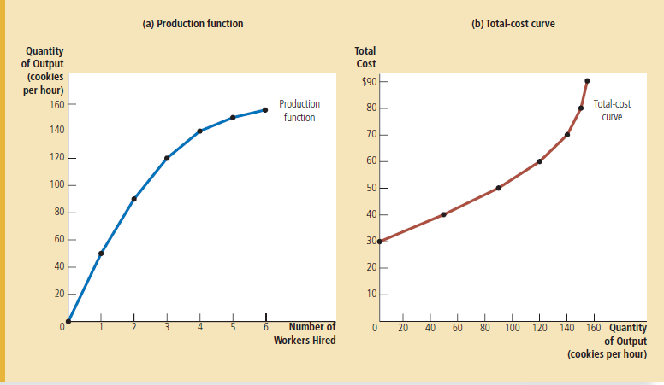

Slide 9
The marginal product of any input in the production process is the increase in the quantity of output obtained from one additional unit of that input. When the number of workers goes from 1 to 2, cookie production increases from 50 to 90, so the marginal product of the second worker is 40 cookies. And when the number of workers goes from 2 to 3, cookie production increases from 90 to 120, so the marginal product of the third worker is 30 cookies and so on.
Why is this happening?
This property is called diminishing marginal product (also an example, I gave earlier for water). At first, when only a few workers are hired, they have easy access to Caroline’s kitchen equipment. As the number of workers increases, additional workers have to share equipment and work in more crowded conditions. Eventually, the kitchen is so crowded that the workers start getting in each other’s way. Hence, as more and more workers are hired, each additional worker contributes fewer additional cookies to total production.
Recall: That is, the slope of the production function measures the marginal product of a worker. As the number of workers increases, the marginal product declines, and the production function becomes flatter.

Slide 10
Compare the production function with the total cost curve
Now compare the total-cost curve in panel (b) with the production function in panel (a). These two curves are opposite sides of the same coin. The total-cost curve gets steeper as the amount produced rises, whereas the production function gets flatter as production rises. These changes in slope occur for the same reason. High production of cookies means that Caroline’s kitchen is crowded with many workers. Because the kitchen is crowded, each additional worker adds less to production, reflecting diminishing marginal product. Therefore, the production function is relatively flat. But now turn this logic around: When the kitchen is crowded, producing an additional cookie requires a lot of additional labor and is thus very costly. Therefore, when the quantity produced is large, the total-cost curve is relatively steep.

Slide 11
Review for Quiz on 4th March 2018
Consumer Surplus, Producer Surplus, Incidence of Tax on Welfare.
Price Floors and Ceilings, (Minimum wage in particular)

Slide 12
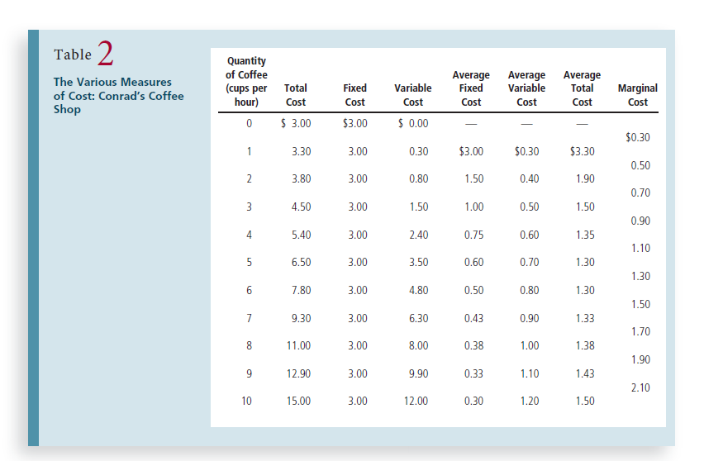
1. Fixed cost:
2. Variable Cost: TC-FC
3. Average Fixed cost = FC/output
4. Average Variable cost = VC/output
5. Average TC = TC/output
6. Marginal cost = change in TC from one unit of output to another.

Slide 13
Types of costs and what we can understand from them?
fixed costs costs that do not vary with the quantity of output produced: rent, heating, lighting.
variable costs costs that vary with the quantity of output produced: packaging, raw materials
average fixed cost is fixed cost divided by the quantity of output
average variable cost variable cost divided by the quantity of output
marginal cost the increase in total cost that arises from an extra unit of production

Slide 14
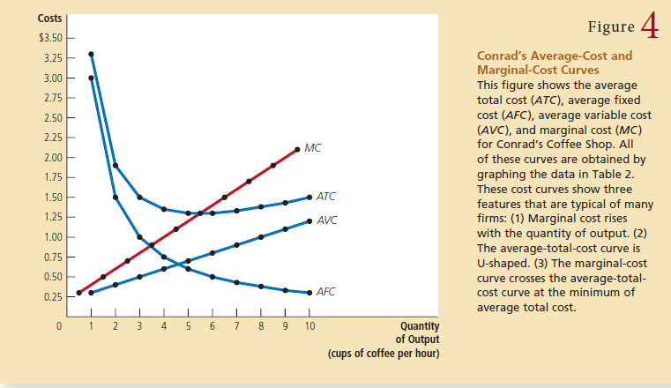

Slide 15
Why are the curves shaped that way?
remember that average total cost is the sum of average fixed cost and average variable cost. Average fixed cost always declines as output rises because the fixed cost is spread over a larger number of units. Average variable cost typically rises as output increases because of diminishing marginal product. Average total cost reflects the shapes of both average fixed cost and average variable cost. At very low levels of output, such as 1 or 2 cups per hour, average total cost is very high. Even though average variable cost is low, average fixed cost is high because the fixed cost is spread over only a few units. As output increases, the fixed cost is spread more widely. Average fixed cost declines, rapidly at first and then more slowly. As a result, average total cost also declines until the firm’s output reaches 5 cups of coffee per hour, when average total cost is $1.30 per cup. When the firm produces more than 6 cups per hour, however, the increase in average variable cost becomes the dominant force, and average total cost starts rising. The tug of war between average fixed cost and average variable cost generates the U-shape in average total cost. \
The bottom of the U-shape occurs at the quantity that minimizes average total cost. This quantity is sometimes called the efficient scale of the firm.

Slide 16
Typical Cost Curves
Figure 5 shows the cost curves for such a firm, including average total cost (ATC), average fixed cost (AFC), average variable cost (AVC), and marginal cost (MC). At low levels of output, the firm experiences increasing marginal product, and the marginal-cost curve falls. Eventually, the firm starts to experience diminishing marginal product, and the marginal-cost curve starts to rise. This combination of increasing then diminishing marginal product also makes the average-variable-cost curve U-shaped.

Slide 17
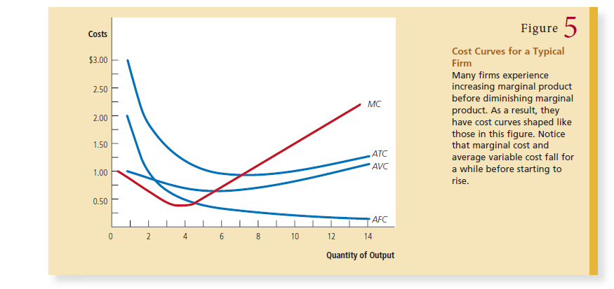

Slide 18
What is common among the curves?
Despite these differences from our previous example, the cost curves shown here share the three properties that are most important to remember:
• Marginal cost eventually rises with the quantity of output.
• The average-total-cost curve is U-shaped.
• The marginal-cost curve crosses the average-total-cost curve at the minimum
of average total cost.

Slide 19
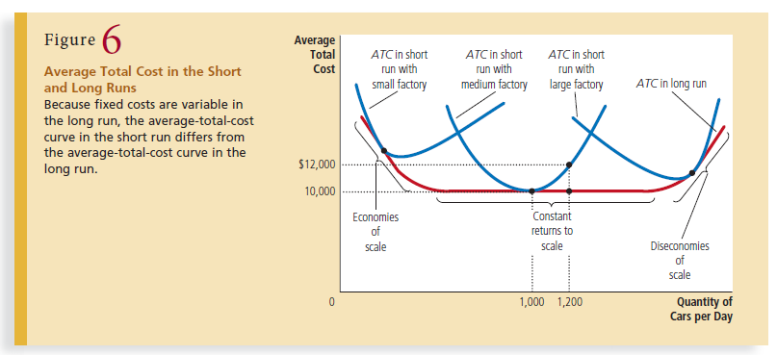

Slide 20
Short Run/Long Run Cost Curves
For many firms, the division of total costs between fixed and variable costs depends on the time horizon. Consider, for instance, a car manufacturer such as Ford Motor Company. Over a period of only a few months, Ford cannot adjust the number or size of its car factories. The only way it can produce additional cars is to hire more workers at the factories it already has. The cost of these factories is, therefore, a fixed cost in the short run. By contrast, over a period of several years, Ford can expand the size of its factories, build new factories, or close old ones. Thus, the cost of its factories is a variable cost in the long run.

Slide 21
Because many decisions are fixed in the short run but variable in the long run, a firm’s long-run cost curves differ from its short-run cost curves. Figure 6 shows an example. The figure presents three short-run average-total-cost curves—for a small, medium, and large factory. It also presents the long-run average-total-cost curve. As the firm moves along the long-run curve, it is adjusting the size of the factory to the quantity of production. This graph shows how short-run and long-run costs are related. The long-run average-total-cost curve is a much flatter U-shape than the short-run average-total cost curve. In addition, all the short-run curves lie on or above the long-run curve. These properties arise because firms have greater flexibility in the long run. In essence, in the long run, the firm gets to choose which short-run curve it wants to use. But in the short run, it has to use whatever short-run curve it has chosen in the past.

Slide 22
What arises from the AC curve?
economies of scale: the property whereby long-run average total cost falls as the quantity of output increases
Diseconomies of Scale: the property whereby long-run average total cost rises as the quantity of output increases
constant returns to scale the property whereby long-run average total cost stays the same as the quantity of output changes

Slide 23
Economies of scale often arise because higher production levels allow specialization among workers, which permits each worker to become better at a specific task. For instance, if Ford hires a large number of workers and produces a large number of cars, it can reduce costs with modern assembly-line production. Diseconomies of scale can arise because of coordination problems that are inherent in any large organization. The more cars Ford produces, the more stretched the management team becomes, and the less effective the managers become at keeping costs down.

Slide 24
This analysis shows why long-run average-total-cost curves are often U-shaped. At low levels of production, the firm benefits from increased size because it can take advantage of greater specialization. Coordination problems, meanwhile, are not yet acute. By contrast, at high levels of production, the benefits of specialization have already been realized, and coordination problems become more severe as the firm grows larger. Thus, long-run average total cost is falling at low levels of production because of increasing specialization and rising at high levels of production because of increasing coordination problems.

Slide 25
